Slide 1
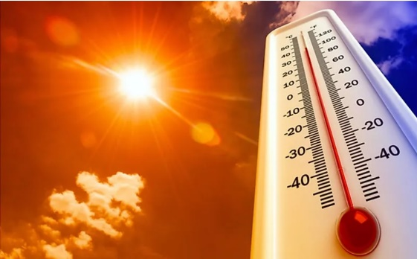
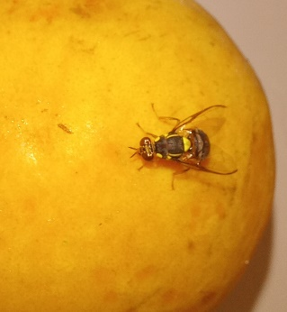
Does thermal history affect field dispersal ability of the oriental fruit fly, Bactrocera dorsalis (Hendel), under diverse environmental conditions?
Kevin Malod^{1*}, Minette Karsten¹, Christopher W. Weldon², John S. Terblanche¹
¹Department of Conservation, Ecology and Entomology, Stellenbosch University, South Africa
²Department of Zoology and Entomology, University of Pretoria, South Africa
Worldatlas.com

Slide 2
Temperature & insects
Ectotherms rely heavily on their environment to reach optimal body temperature
Temperature modulates life-history traits in insects: growth, reproduction, lifespan, stress resistance, dispersal
Temperature
Growth
Lifespan

Slide 3
Acclimation
Successful flight
Modification in a trait as a physiological response to change in an environmental variable
Usually improves performance:
- if acclimation to same TºC
- if acclimation to cold TºC
- if acclimation to hot TºC
Fail
Esterhuizen et al. 2014

Slide 4
Temperature & dispersal ability
Dispersal ability is affected by thermal environment and history
Each species has its own optimal temperature associated with greater flight performance
Understanding how temperature affects dispersal ability of agricultural pest is key
=> successful biological control (e.g. SIT, quarantine zones, etc)

Slide 5
The oriental fruit fly, Bactrocera dorsalis (Hendel)
Native to Asia
Highly invasive: ± 65 countries (CABI)
Polyphagous and major pest to the agricultural industry
© Nina Parry

Slide 6
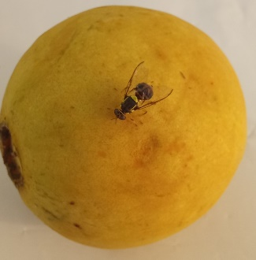
Dispersal ability of B. dorsalis
Bactrocera species are great dispersers (Weldon et al. 2014; Hicks et al. 2019)
Especially B. dorsalis, release-recapture studies ≃ 2 km (up to +90 km)
Thermal preference for long distance flights: 20 to 24ºC (Makumbe et al. 2020)
Effect of adult thermal history not documented

Slide 7
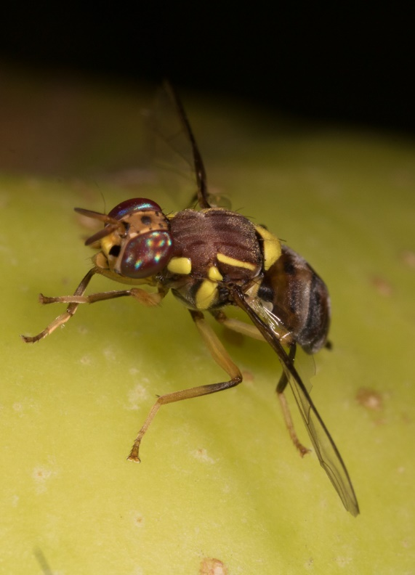
Aims & Predictions
Determine the influence of adult thermal history on the dispersal performance of B. dorsalis in an agricultural environment
Is hot better? Cold? Or a given temperature for a given environment?
The best temperature treatment would depend on the field conditions
?
© Nina Parry

Slide 8
Experimental design
Mass collection of pupae (≃ 5000-6000) hosted at 25ºC
Pupae irradiated at 100 Gy 24-48h before emergence (NICD)
Pupae divided into 3 groups and marked (2 g/L) with fluorescent powders (yellow, orange or red)

Slide 9
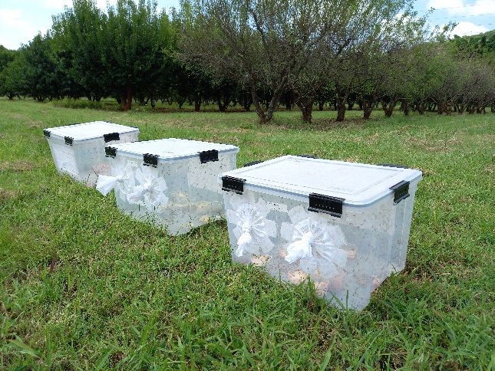
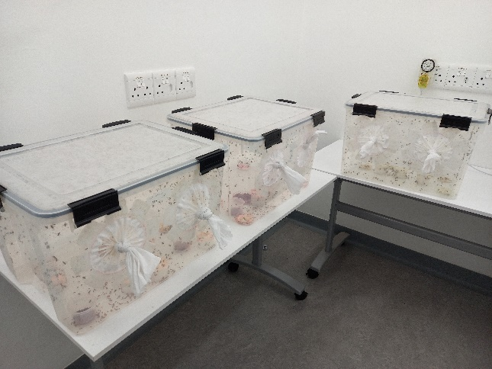
Experimental design
pupae
25ºC
field release
emergence
20ºC
adults
25ºC
30ºC
25ºC for 6 days
4 days acclimation

Slide 10
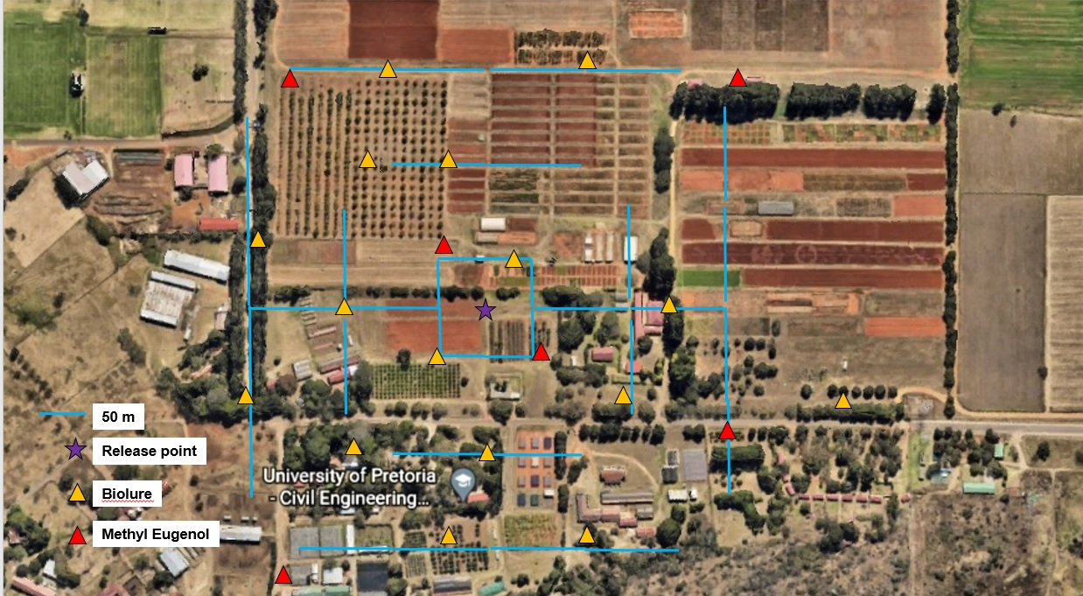
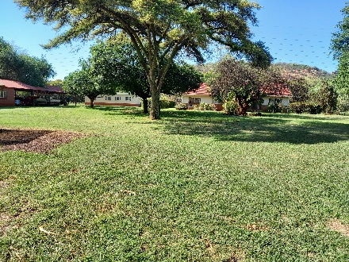
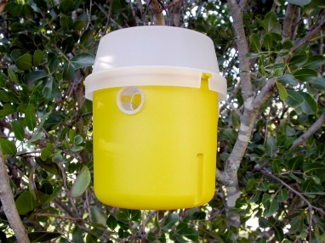
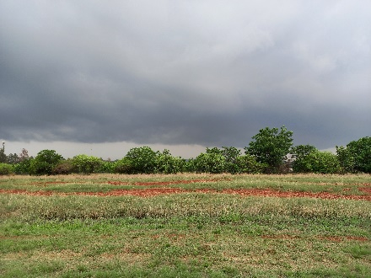
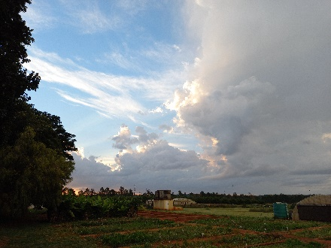
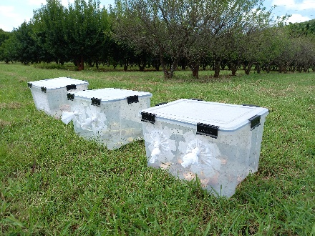
Agricultural environment: Innovation Africa (UP)
©FruitFly Africa

Slide 11
Experimental design
Record temperature and humidity (10 min interval): Ibuttons x3 per site (release / South / North)
Count (field) and identify (lab) flies caught in trap every day (first week) / every second day (past 7 days)
Data analyzed with generalized linear mixed effect models (repeated measures)

Slide 12
Results
R1
R2
20°C
25°C
30°C
Unidentified
Flies captured (%)
Significant effect of acclimation, but replicate dependent: 25ºC (R2) vs 30ºC (R1)
Average daily temperature: R1 = 21.77 ± 2.52ºC; R2 = 20.84 ± 2.13ºC

Slide 13
Results
R1
R2
20°C
25°C
30°C
Unidentified
Flies captured (%)
Average daily maximum temperature: R1 = 31.63 ± 4.06ºC; R2 = 30.37 ± 3.25ºC
Average daily minimum temperature: R1 = 15.04 ± 1.83ºC; R2 = 15.00 ± 2.34ºC
Daily average relative humidity: R1 = 62.46 ± 17.46%; R2 = 71.73 ± 12.47%

Slide 14
Effect of temperature on captures
R1
R2
20°C
25°C
30°C
Daily number of flies captured
Daily average temperature (°C)
Captures significantly increase as temperature increase

Slide 15
Dynamic of the captures
R1
R2
20°C
Cumulative captures (%)
25°C
30°C
Days
50 % of the flies captured within the first week

Slide 16
Temperature & relative change in captures
20°C
R1
R2
25°C
30°C
Percent change in daily captures (log n+1)
ΔT(°C)

Slide 17
Discussion
Dispersal performance of B. dorsalis affected by an interaction between the environmental conditions faced and acclimation treatment
Cold acclimation is not better => a specific temperature for a given environment (optimal and deleterious acclimation hypotheses)
Captures increase with temperature, most likely due to increased dispersal
=> optimization of physiological processes (flight muscles?)

Slide 18
Take home messages
B. dorsalis is more likely to disperse after acclimation to intermediate or warm T ºC
Regardless of acclimation, warmer conditions promote fly captures (to what extent?)
Higher capture rate may indicate better flight performance
=> to be verified in the lab

Slide 19
Acknowledgements
University of Pretoria
Citrus Research International
National Institute for Communicable Diseases
Quentin Guignard

